Slide 1
Interview Preparation:
How to Ace Your Interview
Presented by:
Denise C. Johnson, J.D.
Career Services Manager USC Career Center

Slide 2
Before the Interview: Practice
Prepare Elevator Pitch
Develop 5-7 key talking points from resume or experience
Know strengths and weakness, but play up strengths
Identify greatest accomplishments and a time you failed
ConnectSC – “Resources” tab -- mock interview module
Notes:
Before the Interview:
Know your skill set and prepare for specific questions - develop key talking points about yourself. Don’t embellish, but play up your strengths. Write down your greatest accomplishments and struggles.
Role Play - do a mock interview to better understand how prepared you are

Slide 3
Focus Statement/Elevator Pitch
Brief summary of your background
Lasts from 30 seconds to 1 minute
Should be memorized (but spoken with casual delivery) so you appear more confident
Usually consists of three parts:
Where you’re from
Where you are now/What you’ve done
Where you’re going
Helps you focus, provides recruiter with positive mindset and sets strong tone for interview

Slide 4
Content of Your Elevator Pitch
The Verbals:
Name
Major/Area of Professional Interest
Internships/Jobs/Research/Fieldwork
Field of Interest/Organizations
The Non-Verbals:
Positive body language
Comfortable transition during conversation
When/Why:
To answer the “Tell Me About Yourself” Question, Informational Interviews, Networking Events, Career Fairs, Elevators

Slide 5
How to Handle Virtual Interviews
Test out your connection beforehand – be familiar with your Zoom/Skype tools
Close all other computer programs
Dress appropriately
Silence is golden
Set the stage
Lights!
Look at the camera
Don’t fidget
It’s OK to say if it’s your first time!

Slide 6
During the Interview - Time For You To Shine:
First impressions (15 seconds)
Attitude is everything
Professional handshake, if offered – CAVEAT! You do not HAVE to shake hands!
Be an engaged and active listener
Use industry language & terms

Slide 7
Traditional Interview Questions
But Be Prepared For …..
Where do you see yourself in 3-5 years?
Why do you want to leave your current job?
Why do you want to work for us?
What are your salary expectations?

Slide 8
Illegal Interview Questions
Race
Age
Gender
Sexual Orientation
Religion
Ancestry
Disabilities
Marital Status
Children
Military Records
Notes:
As with most illegal questions, it’s in your interest to answer without taking noticeable offense.
If you are asked an illegal interview question or the questions begin to follow an illegal trend, you always have the option to end the interview or refuse to answer the question. It may be uncomfortable to do, but you need to be comfortable working at the company.:
In the moment, it can be best to try to move through this potential pitfall as gracefully as possible. But afterward, take the time to reflect on your feelings and whether or not this is someone you want to work for,”
Religion
During an interview, an interviewer can ask if you can work during the normal hours of operation of the business. An interviewer cannot ask your religious affiliation or holidays that you observe. It is illegal to be asked your place of worship or your beliefs. If you are asked questions of this kind, you may reply that your faith will not interfere with your ability to do the job.
Race
you can refuse to answer, stating simply, "This question does not affect my ability to perform the job."
Age
If faced with these questions you can choose not to answer, or answer with the truthful, if vague, "My age is not an issue for my performance in this job."
Disability:
. If you choose to reply, you can state "I am confident that I will be able to handle the requirements of this position."
Military
You may not be asked about your type of discharge or about your military records unless it relevant to the job you are applying for.

Slide 9
Examples of Illegal and Legal Questions
Illegal | Legal
Are you married? Do you have permanent partner? How many children do you have? Do they attend daycare? | Do you have responsibilities or commitments that will prevent you from meeting specific work schedules?
Questions about past drug or alcohol use/problems; current use of legal prescribed prescription drugs? | Are you currently using illegal drugs? Have you used illegal drugs in the recent past?
What is your marital status? What is your spouse’s name? What is your maiden name? | Do you have any relatives that work for us or a competitor? Name a contact person in case of emergency.

Slide 10
Behavioral Interview Examples
Describe a time you managed multiple research projects & how you handled them
Share with me a time when your leadership skills were tested
Tell me about your experience working with a team during a conflict
Describe a time you had to make a difficult decision
Tell me about a time you failed
Use STAR Theory To Answer Behaviorals:
S -- Situation
T -- Task
A -- Action
R – Result

Slide 11
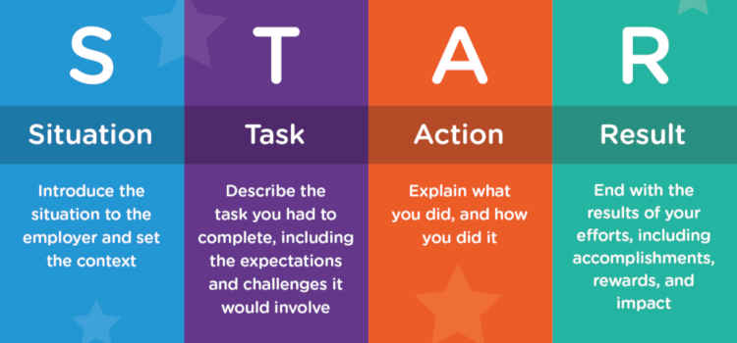

Slide 12
The 12 Core Competencies
1. Teamwork | 7. Decision Making
2. Communication | 8. Initiative
3. Adaptability | 9. Work Standards
4. Reliability | 10. Problem Solving
5. Motivation | 11. Stress Tolerance
6. Integrity | 12. Organizing

Slide 13
Common Interview Mistakes That
Impact
Your
Overall Impressions

Slide 14
Questions for the Interviewer
Specifics about the job & additional responsibilities
Typical day-to-day work and interactions
Employer desired milestones for the new hire
First-priority upon starting in position
If all else fails, go with semi-personal questions –
Hiring manager’s background in organization
What they enjoy most or look forward to regarding job
Next steps & hiring timeframe
Get interviewer's business card or contact information

Slide 15
Thank You Notes
Handwritten note or can be email
Concerns with legibility – type it
Thank you note checklist
Keep it 3-5 sentences
Thank the interviewer first
Express enthusiasm
Personalize it -- highlight a key point from your interview that will make the interviewer remember you
Reiterate your expertise and interest
Proofread! Proofread! Proofread! Always check for spelling and punctuation issues.
CAVEAT: If you send an email prior to a handwritten note, make sure the content in both notes is different!
Notes:
A handwritten thank you note is your personalized acknowledgement of the time and effort the recruiting team has dedicated to your candidacy. If you choose to e-mail an employer a thank you note prior to sending a handwritten one, be sure the content in both notes is different.

Slide 16
Thank You Note Example
May 20, 2020
Dear Ms. Twix,
Thank you for the opportunity to meet with you virtually yesterday. I enjoyed talking with you and Mr. Wonka about the future of the Chocolate Factory and my possible future there. Our conversation has increased my interest in the operations position we discussed and assured me of my ability to provide you with an immediate contribution.
Thanks again for your time. I look forward to hearing from you soon.
Sincerely,
Reese’s Peanut Butter Cup
Notes:
A handwritten thank you note is your personalized acknowledgement of the time and effort the recruiting team has dedicated to your candidacy. If you choose to e-mail an employer a thank you note prior to sending a handwritten one, be sure the content in both notes is different.

Slide 17
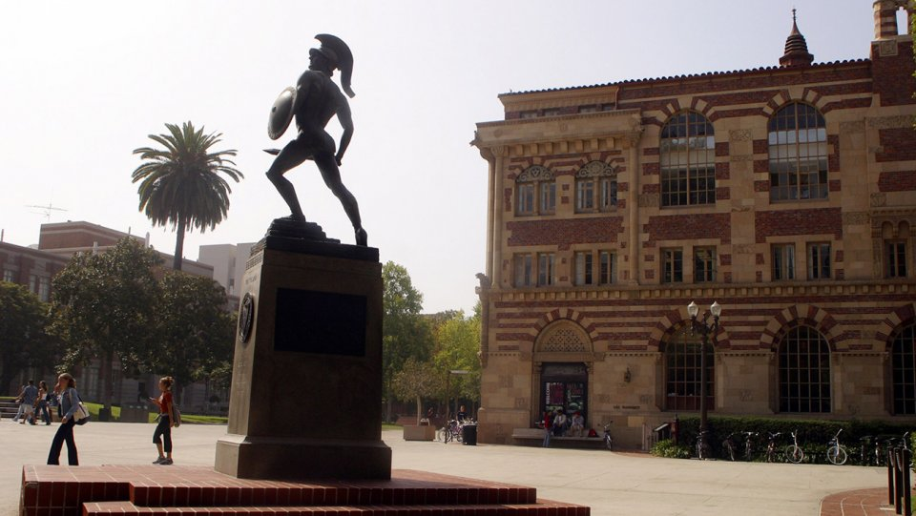
CAREER SERVICES at USC
FOR MORE INFORMATION
USC Career Center
3601 Trousdale Parkway
Student Union Building 110
Los Angeles, CA 90089-4897
(213) 740-9111
careers@usc.edu
http://careers.usc.edu
Hours: 8:30 am – 5:00 pm daily
https://careers.usc.edu/students/interviewing/

